Slide 1

Eclipse RAP
Dima Ionut Daniel

Slide 2
Contents
What is Eclipse RAP?
Eclipse RAP Goals
Architecture
RCP vs RAP
Runtime Layer
SWT/Jface
Basics
Application Configuration
Deployment
Conclussion
Bibliography

Slide 3

What is Eclise RAP?
Eclipse RAP (Remote Application Platform) is an open-source software project under the Eclipse Project.
It aims to enable software developers to build Ajax-enabled rich Internet applications by using the Eclipse development model.
It can be considered a counterpart for web development to the Rich Client Platform (RCP)
RAP encourages sharing source code between RCP and RAP applications to reduce the development effort for business applications that need both desktop-based and web-based front ends.

Slide 4
Eclise RAP Goals
Eclipse Rich Ajax Platform (RAP) helps developers to build rich web clients.
Eclipse RAP multiple goals:
Event-driven web application design
Supporting web application programming using Java APIs
Developing web applications like Java SWT applications
Bringing the Eclipse Rich Client Platform (RCP) to the Web
Customizing web applications using plug-ins
Evolving RCP applications with great code reuse

Slide 5
Eclise RAP Goals (cont.)
Components have some controller and view logic, and just need a model plugged in to do their unit of work.
SWT relies on the operating system for rendering.
SWT, which was created as part of Eclipse.
RAP encapsulates Ajax technologies into simple-to-use Java components the same way SWT encapsulates native widgets.
Eclipse RCP is a very powerful framework.
Plug-ins can be used to support customization.
Eclipse RAP enables existing RCP application to be used on the Web.

Slide 6
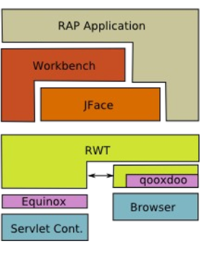
Architecture
Eclipse RAP can be see as SWT(Standard Widget Toolkit) for the Web.
RWT (RAP Widget Toolkit) uses qooxdoo Javascript library to render widgets in the browser.
RWT implements most (40+) SWT Widgets, including their events and layout manager.

Slide 7
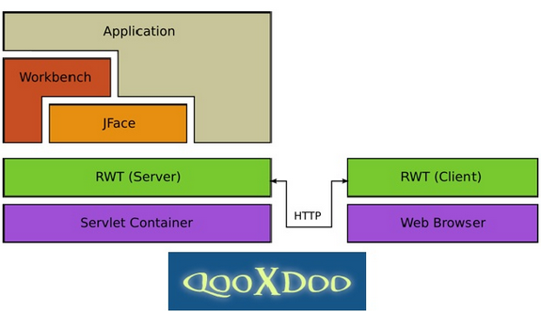
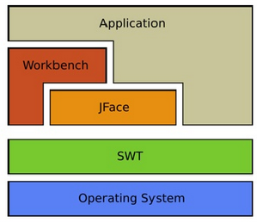
RCP vs RAP
RCP Layers
RAP Layers

Slide 8
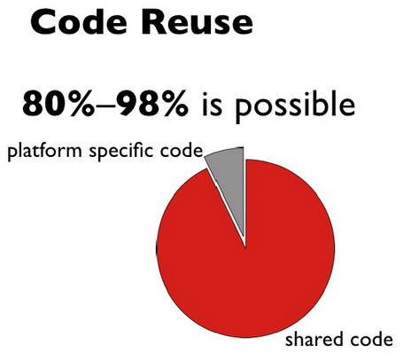
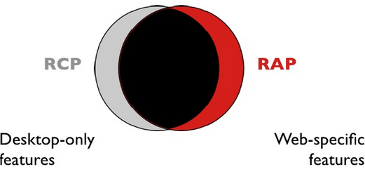
RCP vs RAP (cont.)
RAP runs in a multi-user environment.
RAP runs in a browser.
Resources (images, colors und fonts) are shared.

Slide 9
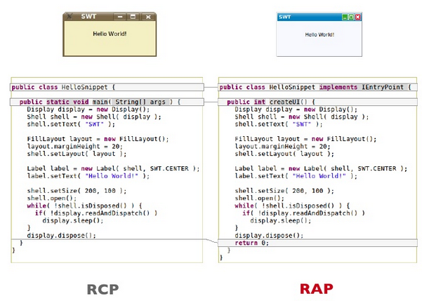
RCP vs RAP (cont.)

Slide 10
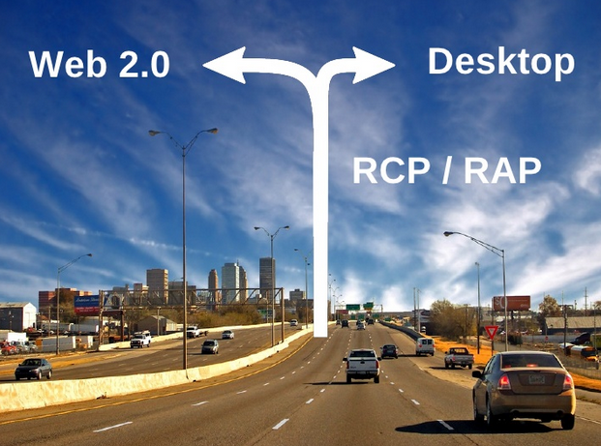
RCP vs RAP (cont.)

Slide 11
Runtime Layer
In RCP the runtime layer is composed of the OS and the JVM.
The JVM is based on OSGI implementation.
OSGi (JSR-291) defines how different modules or plug-ins (called bundles), can expose their services.
Above OSGi is SWT.
For RAP, there are two existing runtimes.
one resides on the server side, powering the main RAP stack,
one resides on the client side, running the user interface part.
The server-side stack of RAP, where the application is running, is almost the same as the RCP one.

Slide 12
Runtime Layer(cont.)
The Server Side:
Equinox is responsible for dependency management of the modules and enables hot deployment of new versions or extensions.
when run, there is just one instance of RAP and the application.
The Client Side:
contains JavaScript engine
qooxdoo is used on the client side as part of the RAP bundle
qooxdoo allows JavaScript widgets to be treated almost the same as SWT widgets
qooxdoo is an open source JavaScript framework created by the German company 1&1 Internet.

Slide 13
SWT/JFace
Standard Widget Toolkit(SWT) API was reimplemented by RAP under the name RAP Widget Toolkit (RWT).
RWT creates the required JavaScript commands that cause qooxdoo to render the appropriate widgets.
The client commands are compressed and sent to the browser using Ajax.
JFace is an addition to SWT, designed to create a friendlier API for developers who did not really like SWT.
RAP maps most of the JFace API.
As the JFace API is also very large and powerful, there are still areas that are just not implemented by RAP.

Slide 14
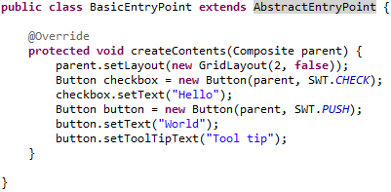

Basics
In order to start the application a org.eclipse.rap.rwt.application.EntryPoint implementation needs to be provided.
The abstract class AbstractEntryPoint contains the createUI() method that creates the SWT objects: Display, Shell; the developers needs to implement the createContents() method in order to create the GUI.

Slide 15
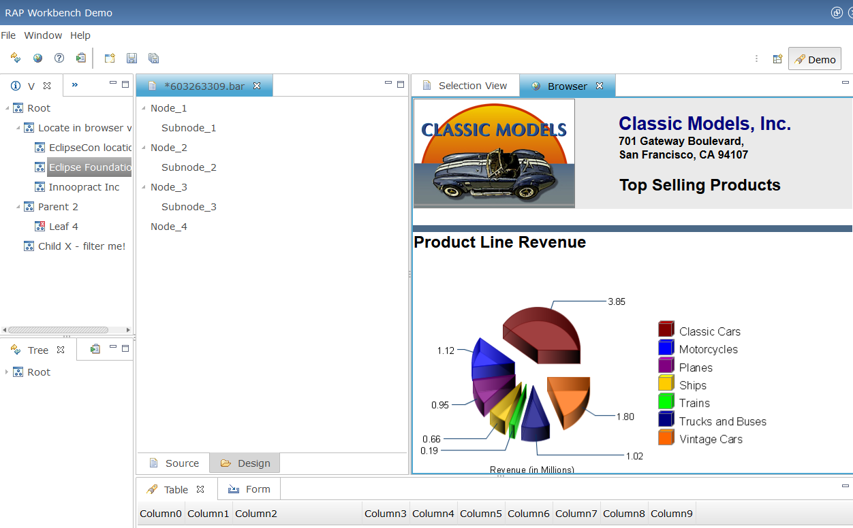
Basics
Notes:
Workbench demo from http://rap.eclipsesource.com/demo/release/workbenchdemo/workbench

Slide 16
Basics
Scopes in RAP
ApplicationContext:
there can be more than one RAP application running at the same time in different web application
can be used to retrieve ResourceManager.
can be obtained using RWT.getApplicationContext().
UISession:
spans exactly one execution of an EntryPoint.
can be obtained using RWT.getUISession().
provides access to session details such as the client object, and also to the underlying HTTP session.

Slide 17
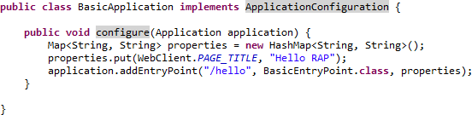
Application Configuration
A RAP application consists of various parts, such as entry points, URL mappings, themes, service handlers, etc.
An application configuration is an implementation of the interface ApplicationConfiguration.
RAP uses a callback approach to configure applications before they are started.
The method configure( Application ) is invoked with a reference to the created Application as the sole argument.
An application may have any number of entry points, each mapped to a separate servlet path.
The third argument of addEntryPoint is an optional map to configure visual aspects of the entry point.

Slide 18
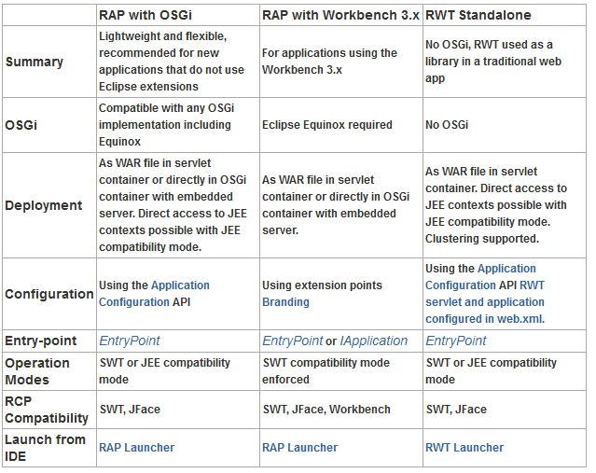
Deployment
RAP can be combined with various other technologies and deployed in different setups.

Slide 19
Conclussion
PROS:
Simple to use
API and documented

Slide 20

Bibliography
http://www.eclipse.org/rap/documentation/
http://en.wikipedia.org/wiki/Remote_Application_Platform
http://www.slideshare.net/rsternberg/single-sourcing-rap-and-rcp-desktop-and-web-clients-from-a-single-code-base-1212420?type=presentation
First Press - Eclipse Rich Ajax Platform Bringing Rich Client to the Web
http://rap.eclipsesource.com/demo/release/workbenchdemo/workbench

Slide 21
Questions ?

